Slide 2
DESE: SCHOOL-BASED MENTAL HEALTH
VISION
The vision of the School-Based Mental Health section is to help create comprehensive school mental health systems to address the full array of these services and supports, including mental health promotion, prevention, early identification and treatment.
TEAM
Name | Position
Lisa Dierking | Coordinator of School-Based Mental Health
Jamie Fuelling | Director of School-Based Mental Health
Danny Rydman | Director of Project AWARE
Notes:
Instructions-Big picture context about your agency that helps school professionals understand the basic purpose/function (broadly, if that’s relevant, but mostly focused on school-based mental health – think roles, programs, policies, reporting/compliance)
Then narrow down to specific sections, divisions, etc. that are most closely engaged in this work

Slide 3
DESE: SCHOOL-BASED MENTAL HEALTH
RESOURCES:
Mental Health Resources for School Staff and Students | Missouri Department of Elementary and Secondary Education (mo.gov)
DESE Application – MHFA Missouri
DESE Youth Suicide Awareness and Prevention Model Policy 03.18 | Missouri Department of Elementary and Secondary Education
Project AWARE Missouri
SHAPE – School Health Assessment and Performance Evaluation (theshapesystem.com)
Administrative Memos | Missouri Department of Elementary and Secondary Education
Agendas, Minutes, & Recordings | Missouri Department of Elementary and Secondary Education (mo.gov)
Notes:
Instructions-Big picture context about your agency that helps school professionals understand the basic purpose/function (broadly, if that’s relevant, but mostly focused on school-based mental health – think roles, programs, policies, reporting/compliance)
Then narrow down to specific sections, divisions, etc. that are most closely engaged in this work

Slide 4
DESE: SCHOOL COUNSELING AND STUDENT WELLNESS
TEAM
VISION
The vision of the School Counseling and Student Wellness section is to work with local school districts to help ensure that each district has a fully implemented comprehensive school counseling program that supports the academic, career, and social/emotional development of all students through the delivery of counseling curriculum, individual student planning, and responsive services.
Name | Position
Chrissy Bashore | Coordinator of School Counseling and Student Wellness
Pat Runge | Director of School Counseling
Cierra Griffin | Assistant Director of School Counseling
Jimmy Hale | Director of Missouri Healthy Schools
Katie Epema | Director of Student Wellness
Notes:
Instructions-Big picture context about your agency that helps school professionals understand the basic purpose/function (broadly, if that’s relevant, but mostly focused on school-based mental health – think roles, programs, policies, reporting/compliance)
Then narrow down to specific sections, divisions, etc. that are most closely engaged in this work

Slide 5
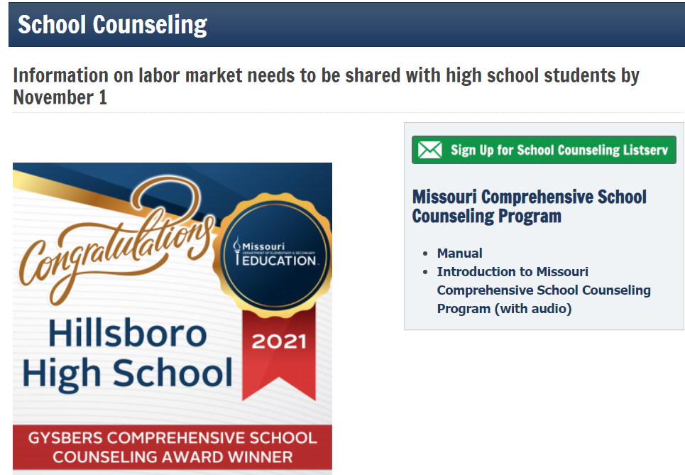
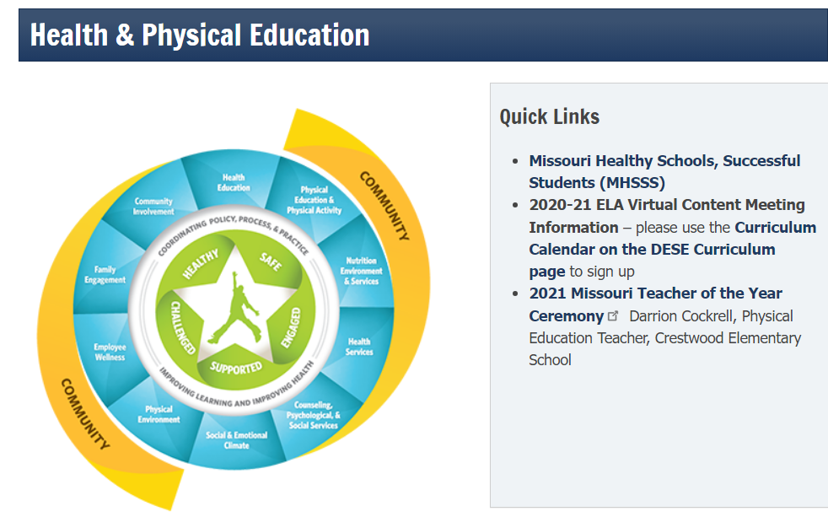
DESE: SCHOOL COUNSELING AND STUDENT WELLNESS
RESOURCES:
DESE School Counseling Website
Listserv
Legislation | Missouri Department of Elementary and Secondary Education (mo.gov)
Trauma-Informed Schools Initiative | Missouri Department of Elementary and Secondary Education (mo.gov)
Care to Learn | Meeting Students' Health, Hunger, and Hygiene Needs
Health & Physical Education | Missouri Department of Elementary and Secondary Education (mo.gov)
Missouri Healthy Schools (mohealthyschools.com)
Notes:
Instructions-Big picture context about your agency that helps school professionals understand the basic purpose/function (broadly, if that’s relevant, but mostly focused on school-based mental health – think roles, programs, policies, reporting/compliance)
Then narrow down to specific sections, divisions, etc. that are most closely engaged in this work

Slide 6
Agency

Slide 7
Department of Mental Health (DMH) Overview
DMH Mission: Serving, empowering and supporting Missourians to live their best lives.
DMH supports school districts with:
Professional Development on Trauma Informed Schools
Consultation and TA
Prevention Resources (Suicide, Substance Use, Mental Illness)
Crisis Response (988, Behavioral Health Crisis Centers)
Youth Behavioral Health Liaisons (YBHLs)
Service delivery for youth with developmental and behavioral health needs
Service coordination with DMH contracted providers serving youth and families
DMH has two divisions that provide services for Missouri youth and adults:
Division of Developmental Disabilities (Intellectual and Developmental Disabilities)
Division of Behavioral Health (Mental Illness, Psychiatric Services, Substance Use Disorders)

Slide 8
DMH Representatives
Amanda Baker, Substance Use Prevention Coordinator
Work with Substance Use Prevention agencies statewide who provide prevention services/education to schools, local communities, and coalitions.
Provide Mental Health First Aid trainings (Adult, Youth, Teen) and Signs of Suicide prevention programming to schools and communities.
Charise Baker, Clinical Coordinator
Consult on clinical coordination for youth with complex needs by promoting continuity of care.
Connect schools with community partners to support youth and families in improving mental health.
Rachel Jones, Director of Trauma Services
Promote trauma informed care across Missouri through education, consultation, technical assistance
Identify evidenced-based practices to reduce trauma exposure

Slide 9
DMH Resources
Substance Use Prevention and Mental Health resources:
Prevention Resource Centers - https://dmh.mo.gov/media/pdf/prevention-resource-network-map
MO Institute of Mental Health – https://mhfamissouri.org
Prevention website – https://dmh.mo.gov/alcohol-drug/prevention
988 Resources – https://dmh.mo.gov/behavioral-health/988-suicide-and-crisis-lifeline
Trauma Informed Care Resources: www.dmh.mo.gov/trauma
Missouri Model for Trauma Informed Schools - https://dmh.mo.gov/media/pdf/missouri-model-trauma-informed-schools
FREE E-Learning Trauma Courses – https://modmh.thinkific.com/
Wellness Resources – www.dmh.mo.gov/wellness
Community Resources:
Children's Services | dmh.mo.gov
Developmental Disabilities | dmh.mo.gov
Map of Certified Community Behavioral Health Organizations | dmh.mo.gov
Missouri Map YBHL POC Counties | dmh.mo.gov

